Slide 1
CSY2082 Introduction to Artificial Intelligence
Decision Trees

Slide 2
Decision Tree
Like SVMs, Decision Trees are versatile Machine Learning algorithms that can perform both classification and regression tasks, and even multioutput tasks.
Decision Trees are also the fundamental components of Random Forests, which are among the most powerful Machine Learning algorithms available today.

Slide 3
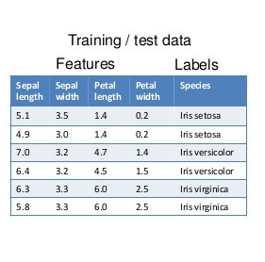

Slide 4
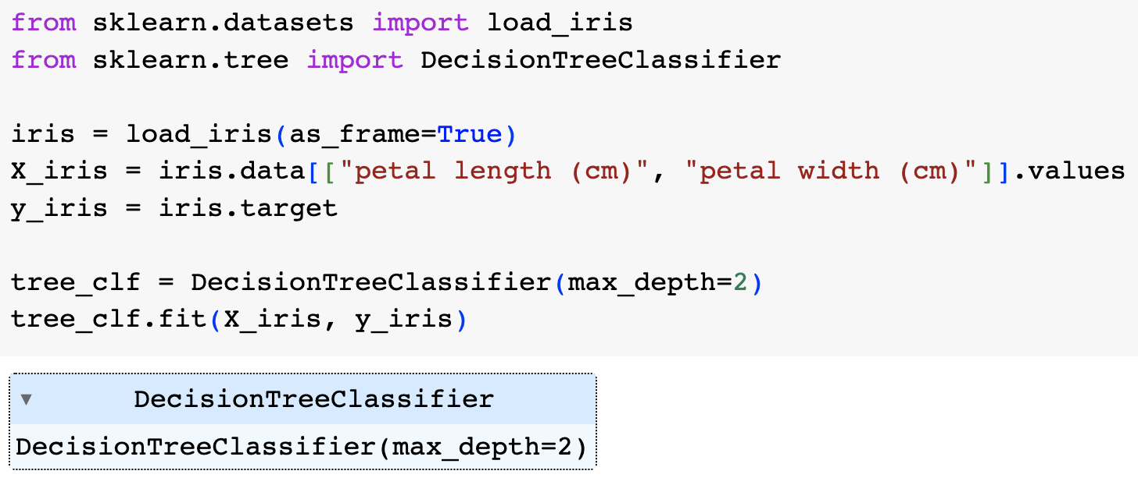
Training and Visualizing a Decision Tree
train a DecisionTreeClassifier on the iris dataset

Slide 5
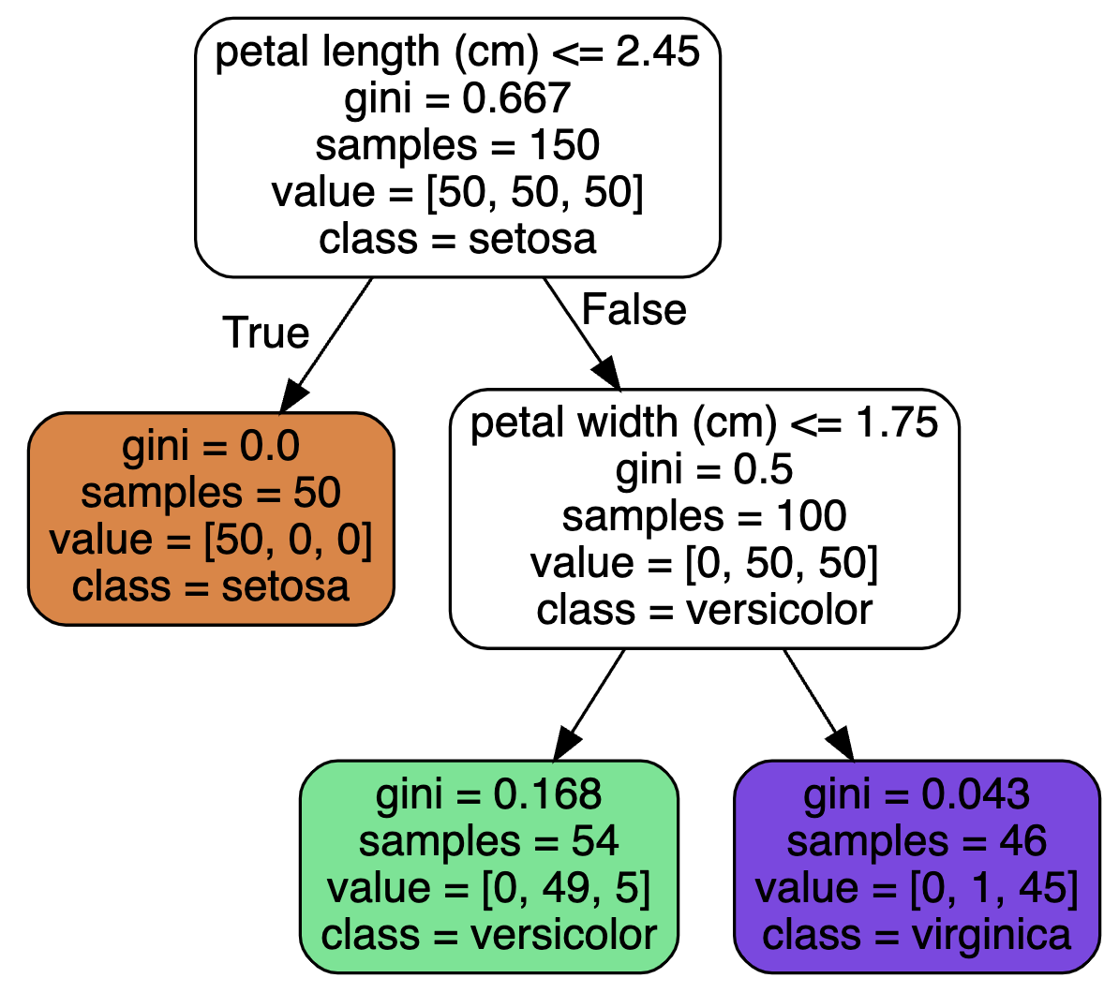
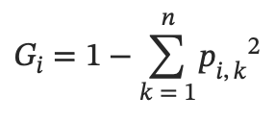
A node’s samples attribute counts how many training instances it applies to.
A node’s value attribute tells you how many training instances of each class this node applies to.
a node’s gini attribute measures its impurity.
Scikit-Learn uses the CART algorithm, which produces only binary trees: non-leaf nodes always have two children.
1 – (0/54)² – (49/54)² – (5/54)² ≈ 0.168.

Slide 6
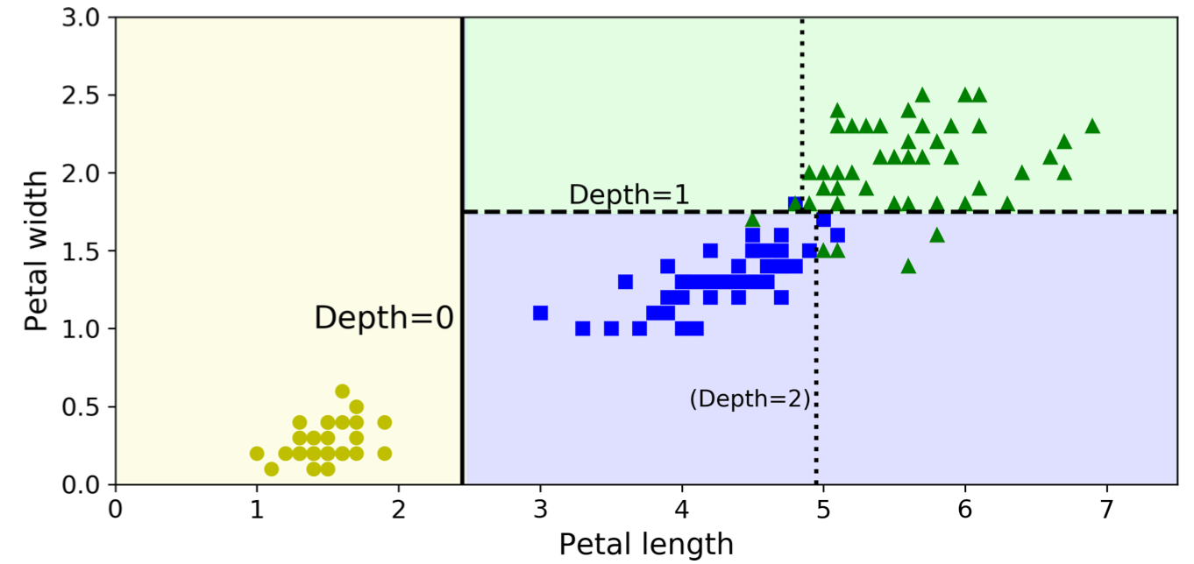
Decision Tree decision boundaries and interpretability
As you can see Decision Trees are fairly intuitive and their decisions are easy to interpret.
Such models are often called white box models. In contrast, neural networks are generally considered black box models.
max_depth=2

Slide 7
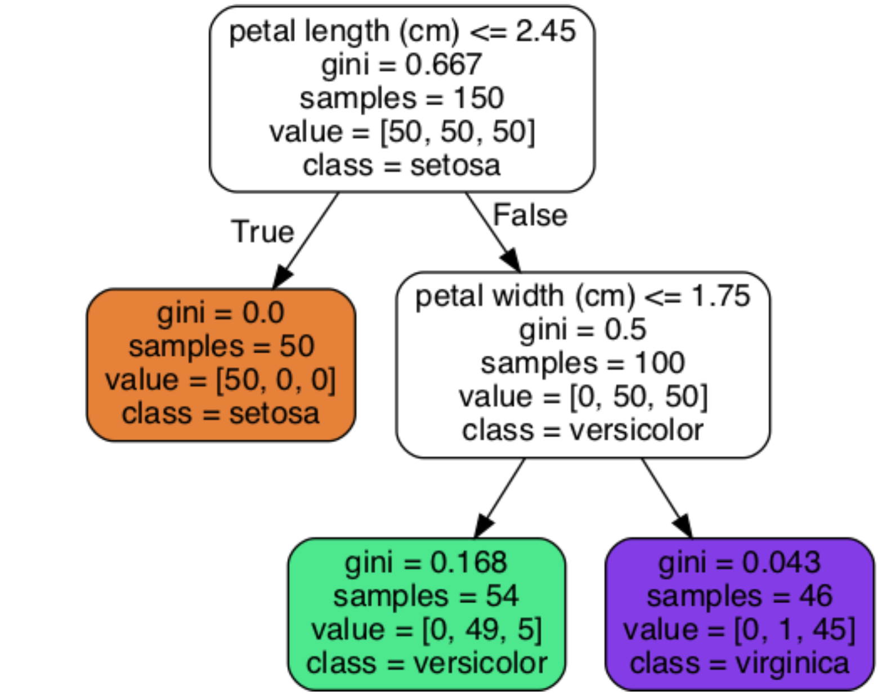
Estimating Class Probabilities
A Decision Tree can also estimate the probability that an instance belongs to a particular class k
first it traverses the tree to find the leaf node for this instance, and then it returns the ratio of training instances of class k in this node.
For example, suppose you have found a flower whose petals are 5 cm long and 1.5 cm wide.
the Decision Tree should output the following probabilities: 0% for Iris-Setosa (0/54), 90.7% for Iris-Versicolor (49/54), and 9.3% for Iris-Virginica (5/54).

Slide 8
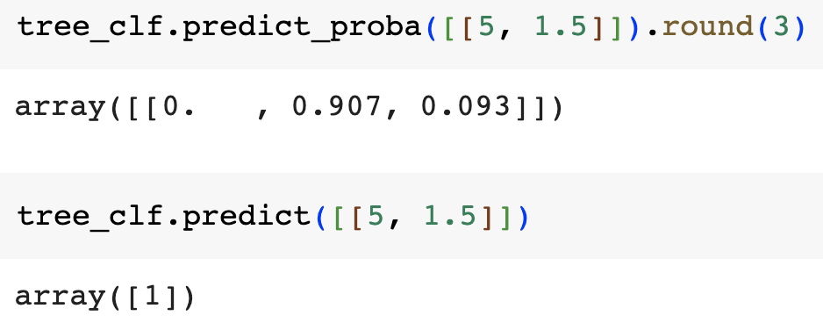
Estimating Class Probabilities

Slide 9
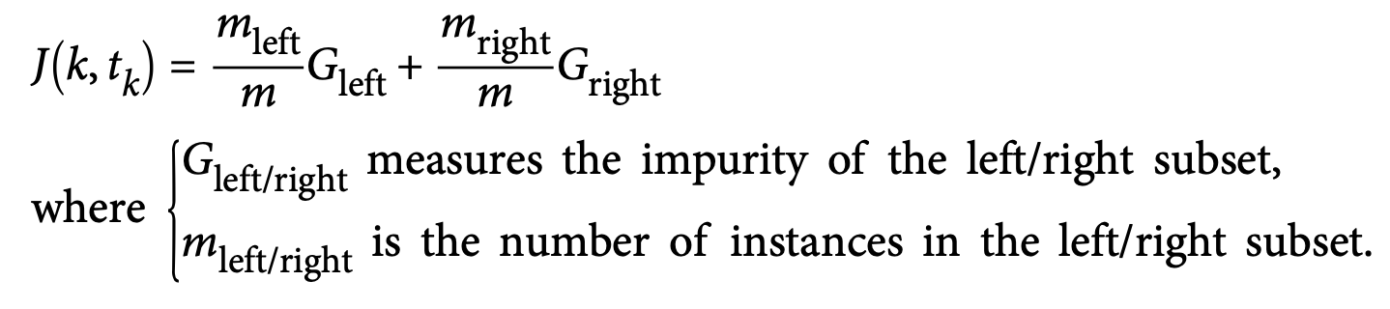
The CART Training Algorithm
Scikit-Learn uses the Classification And Regression Tree (CART) algorithm to train Decision.
The idea is really quite simple: the algorithm first splits the training set in two subsets using a single feature k and a threshold tk (e.g., “petal length ≤ 2.45 cm”) recursively.
It searches for the pair (k, tk) that produces the purest subsets (weighted by their size).

Slide 10
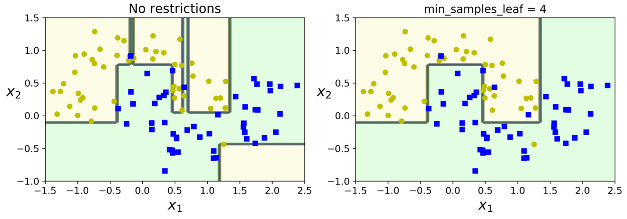
Regularization
To avoid overfitting the training data, you need to restrict the Decision Tree’s freedom during training such as restricting the maximum depth of the Decision Tree.
The DecisionTreeClassifier class has a few other options: min_samples_split (the minimum number of samples a node must have before it can be split), min_samples_leaf (the minimum number of samples a leaf node must have), max_leaf_nodes (maximum number of leaf nodes), and max_features (maximum number of features that are evaluated for splitting at each node).

Slide 11
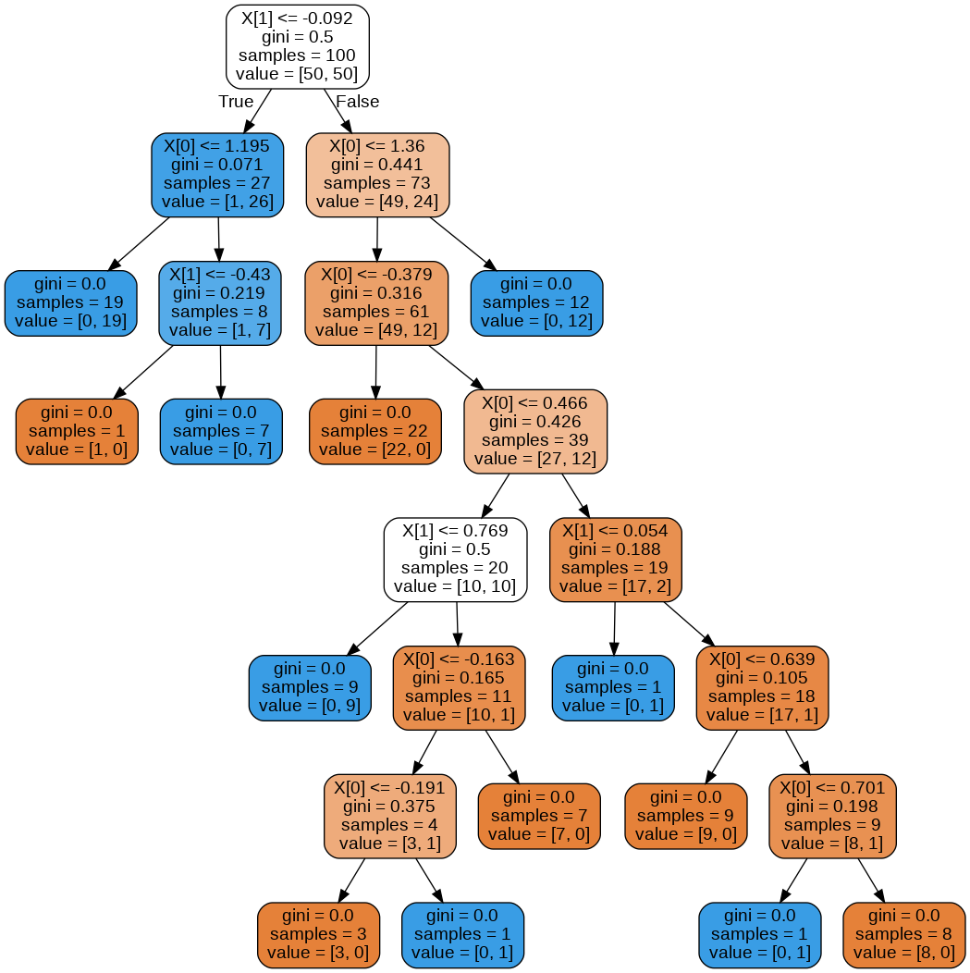
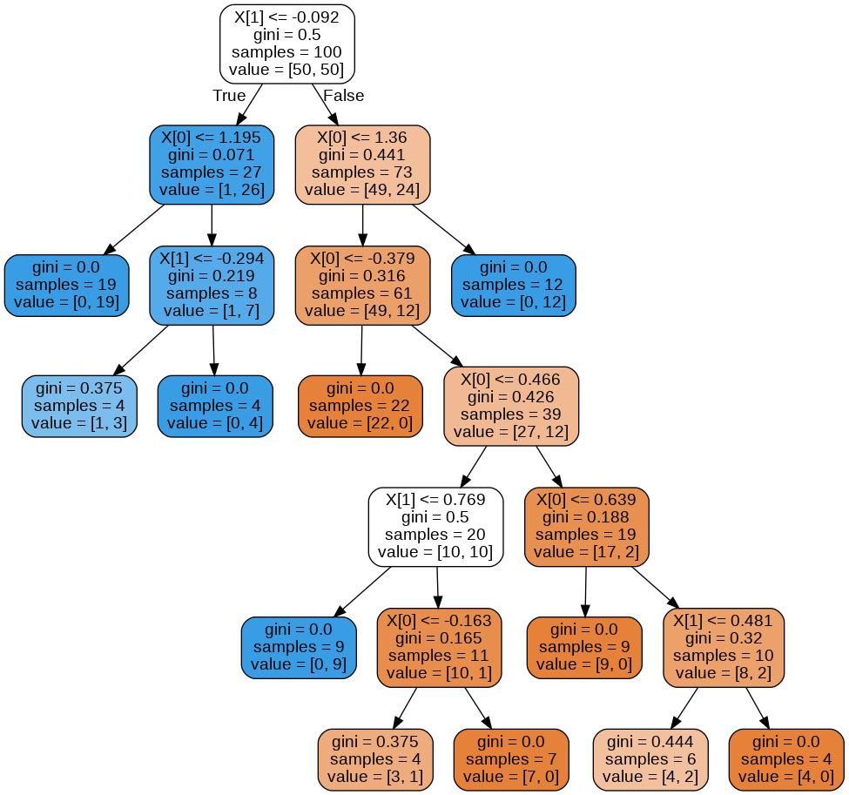

Slide 12
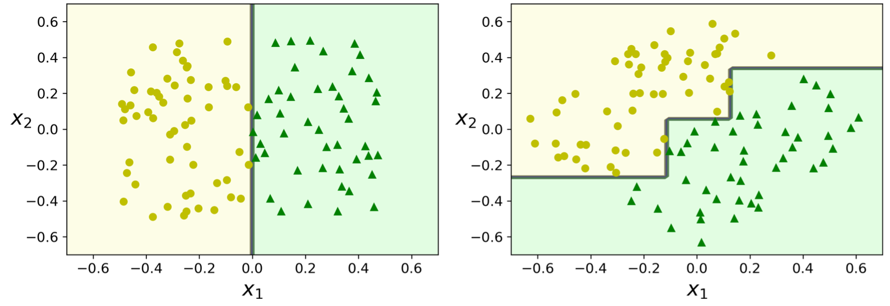
Instability
First, as you may have noticed, Decision Trees love orthogonal decision boundaries (all splits are perpendicular to an axis), which makes them sensitive to training set rotation.
On the left, a Decision Tree can split it easily, while on the right, after the dataset is rotated by 45°, the decision boundary looks unnecessarily convoluted and won’t generalise well..

Slide 13
Exercise
Run the code to build the decision tree multiple times. Do you always get the same tree?
If you are getting different trees, how do you know which one to use for your application? Compare their performance.

